Slide 1
Chapter 5
Digital Design and Computer Architecture, 2nd Edition
David Money Harris and Sarah L. Harris

Slide 2
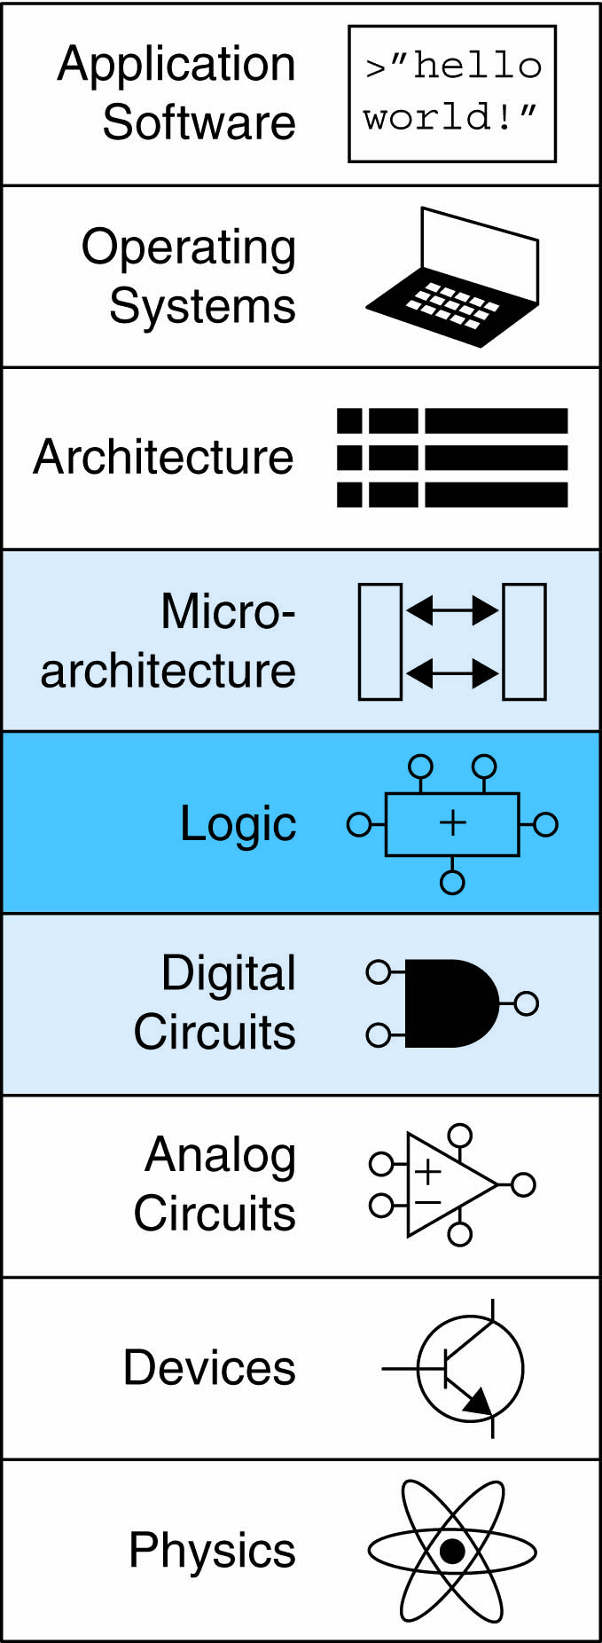
Chapter 5 :: Topics
Introduction
Arithmetic Circuits
Number Systems
Sequential Building Blocks
Counters
Shift registers
Memory Arrays
Logic Arrays

Slide 3
Counters
Increments on each clock edge
Used to cycle through numbers. For example,
000, 001, 010, 011, 100, 101, 110, 111, 000, 001…
Example uses:
Digital clock displays
Program counter: keeps track of current instruction executing
An adder and a resettable register
On each cycle, the counter adds 1 to the vale stored in the register

Slide 4
Shift Registers
Shift register has a clock, a serial input S_{in}, a serial output S_{out}, and N parallel output Q_{0:N-1}.
On each rising edge of the clock, a new bit is shifted in from S_{in} and all the subsequent contents are shifted forward. The last bit in the shift register is available at S_{out}.
Shift registers can be viewed as serial-to-parallel converter.
The input is provided serially (one bit at a time) at S_{in}. After N cycles, the past N inputs are available in parallel at Q.
Symbol:

Slide 5
Shift Registers
A shift register can be constructed from N flip-flops connected in series.
Symbol:
Implementation:

Slide 6
Shift Registers
Don’t get confused shift registers with the shifters

Slide 7
Shift Registers
Don’t get confused shift registers with the shifters
Shift registers are sequential logic blocks that shift in a new bit on each clock edge.
Shifters are unclocked combinational logic blocks that shift an input by a specified amount.

Slide 8
Memory Arrays
Efficiently store large amounts of data
3 common types:
Dynamic random access memory (DRAM)
Static random access memory (SRAM)
Read only memory (ROM)
M-bit data value read/ written at each unique N-bit address

Slide 9
Memory Arrays
2-dimensional array of bit cells
Each bit cell stores one bit
N address bits and M data bits:
2^{N} rows and M columns
Depth: number of rows (number of words)
Width: number of columns (size of word)
Array size: depth × width = 2^{N} × M

Slide 10
Memory Array Example
2² × 3-bit array
Number of words: 4
Word size: 3-bits
For example, the 3-bit word stored at address 10 is 100

Slide 11
Memory Arrays

Slide 12
Memory Array Bit Cells
READ
= Z
ON
0 or 1
ON

Slide 13
Memory Array Bit Cells
WRITE
0 OR 1
ON
0 or 1

Slide 14
Memory Array
Wordline:
like an enable
single row in memory array read/written
corresponds to unique address
only one wordline HIGH at once

Slide 15
Types of Memory
Random access memory (RAM): volatile
Read only memory (ROM): nonvolatile

Slide 16
RAM: Random Access Memory
Volatile: loses its data when power off
Read and written quickly
Main memory in your computer is RAM (DRAM)
Historically called random access memory because any data word accessed as easily as any other (in contrast to sequential access memories such as a tape recorder)

Slide 17
ROM: Read Only Memory
Nonvolatile: retains data when power off
Read quickly, but writing is impossible or slow
Flash memory in cameras, thumb drives, and digital cameras are all ROMs
Historically called read only memory because ROMs were written at manufacturing time or by burning fuses. Once ROM was configured, it could not be written again. This is no longer the case for Flash memory and other types of ROMs.

Slide 18
Types of RAM
DRAM (Dynamic random access memory)
SRAM (Static random access memory)
Differ in how they store data:
DRAM uses a capacitor
SRAM uses cross-coupled inverters

Slide 19
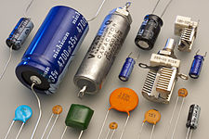
DRAM
Data bits stored on capacitor
Dynamic because the value needs to be refreshed (rewritten) periodically and after read:
Charge leakage from the capacitor degrades the value
Reading destroys the stored value

Slide 20
DRAM
Capacitor is charged to V_{DD},
the stored bit is 1
Capacitor is discharged to GND
the stored bit is 0
READ: data values are transferred from the capacitor to the bitline
WRITE: data values are transferred from the bitline to the capacitor

Slide 21
SRAM
Wordline is asserted, both transistors turn ON,
data values are transferred to or from the bitlines

Slide 22
Memory Arrays Review
DRAM bit cell:
SRAM bit cell:

Slide 23
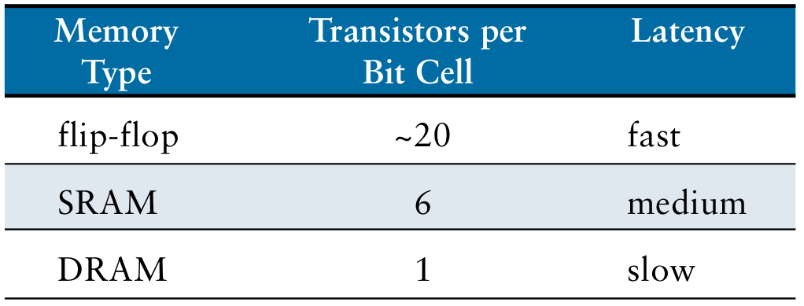
Memory Comparison
Flip-flops, SRAMs and DRAMs are all volatile memories

Slide 24
ROM: Dot Notation

Slide 25
ROM Storage

Slide 26
ROM Logic
Data₂ = A₁ ⊕ A₀
Data₁ = A₁ + A₀
Data₀ = A₁A₀

Slide 27
Example: Logic with ROMs
Implement the following logic functions using a 2² × 3-bit ROM:
X = AB
Y = A + B
Z = A B

Slide 28
Example: Logic with ROMs
Implement the following logic functions using a 2² × 3-bit ROM:
X = AB
Y = A + B
Z = A B

Slide 29
Logic with Any Memory Array
Data₂ = A₁ ⊕ A₀
Data₁ = A₁ + A₀
Data₀ = A₁A₀

Slide 30
Logic with Memory Arrays
Implement the following logic functions using a 2² × 3-bit memory array:
X = AB
Y = A + B
Z = A B

Slide 31
Logic with Memory Arrays
Implement the following logic functions using a 2² × 3-bit memory array:
X = AB
Y = A + B
Z = A B

Slide 32
Logic with Memory Arrays
Memory arrays used to perform combinational logic functions are called lookup tables (LUTs)
The user can look up output at each input combination (address)

Slide 33
Multi-ported Memories
Port: address/data pair
3-ported memory (can access several addresses simultaneously)
2 read ports (A1/RD1, A2/RD2)
1 write port (A3/WD3, WE3 enables writing)
Register file: small multi-ported memory
Port 1 reads the data from address A1 onto the read data output RD1
Port 2 reads the data from address A2 onto the read data output RD2
Port 3 writes the data from the write data input WD3 into address A3 on the rising edge of the clock if write enables WE3 is asserted

Slide 34
Logic Arrays
Like memory, gates can be organized into regular arrays.
If the connections are made configurable, these logic arrays can be configured to perform any function without the user having to connect wires in specific ways.
Two types of logic arrays:
PLAs (Programmable logic arrays)
FPGAs (Field programmable gate arrays)

Slide 35
Logic Arrays
PLAs (Programmable logic arrays)
AND array followed by OR array
Combinational logic only
Fixed internal connections
FPGAs (Field programmable gate arrays)
Array of Logic Elements (LEs)
Combinational and sequential logic
Programmable internal connections

Slide 36
PLAs
X = ABC + ABC
Y = AB

Slide 37
PLAs: Dot Notation

Slide 38
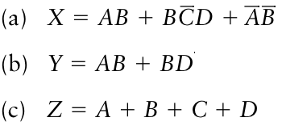
Exercise
Implement the following functions using a single 16 x 3 ROM.
Use dot notation to indicate the ROM contents.

Slide 39
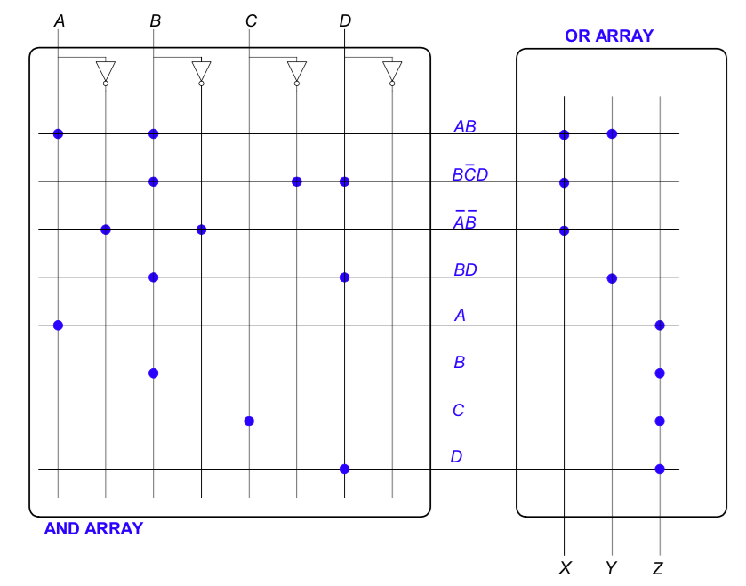
Solution

